Slide 1
Expert System
Dr. S. D. Raut
Dept of Comp Sci & Application,
School of Computational Sciences,
P. A. Holkar Solapur University, Solapur.
Mail Id : sdraut@sus.ac.in

Slide 2
Introduction
An interactive computer based Decision tool.
Uses both facts and Heuristics.
A Problem solver of a specialized domain
that ordinarily requires Human Expertise
Successful forms of AI Software.

Slide 3
A Computer System to solve complex problem
Is an imitation of the Human Expert.
Unique structure based on-
Inference Engine
Knowledge base
Inference Engine + Knowledge = Expert System

Slide 4
Components - Expert System
Knowledge Base
A declarative representation of the Expertise.
Often in IF then Rules.
Working Storage
Data Specific to problem being solved.

Slide 5
Continued..
Inference Engine
A Code at core to derive recommendation from working storage
User Interface
Dialogue between User and System.

Slide 6
Key – Role Player
1. Domain Expert
Human Expert to solve problems
2. Knowledge Engineer
Encodes expert’s knowledge in declarative form to stand expert system
3. User
Consulting with Expert System to get advice from it.

Slide 7
Expert System Shell
Many Expert System are built from expert system shell
A shell is a piece of software
Contains User interface
A format for declarative knowledge in knowledge base
An inference Engine

Slide 8
System Shell
System Engineer
Builds User Interface
Design Declarative format for knowledge base
Implements Inference Engine.
Knowledge Engineer
Use Shell to solve particular problem domain

Slide 9
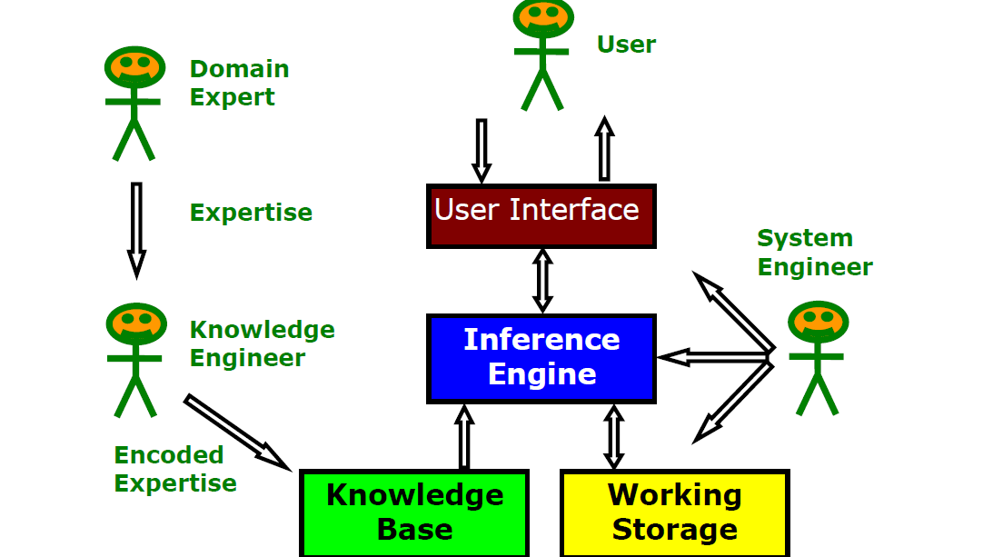

Slide 10
Expert Task
Engineering
Design
Fault finding
Manufacturing planning
Scientific Analysis
Medical Diagnosis
Financial Analysis

Slide 11
Characteristics
Applied AI in a very broad sense.
Operates as an interactive system
Responds to a question
Asks for clarification
Makes recommendations
Aids Decision-making process.

Slide 12
Characteristics
Tools have ability to filter knowledge
Storage and retrieval of knowledge
Mechanism to expand and update knowledge
Based on continuing basis
Make logical inference based on knowledge stored.

Slide 13
Characteristics
Domain Specific
A system provide a particular area of specialization
E.g. Medical expert system can’t be used for engineering design.
Quality of advice depends on knowledge acquired from expert

Slide 14
Continued..
Ability to explain reasoning.
A logical chain reasoning
User may asks
For explanation of a Recommendations
Factors considered in Recommendations.
Cost Effective alternative to Human Expert

Slide 15
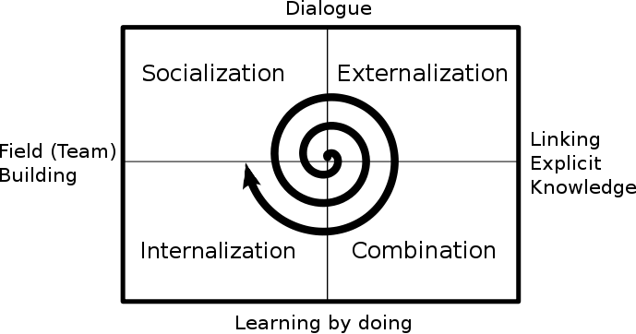

Slide 16
Factors
Goal Driven Reasoning
An inference technique
Uses IF then Else repetitively
Break goal into sub-goals and are easier to prove
Backward chaining is efficient way to solve problems

Slide 17
Continued..
Uncertainty
Imperfect knowledge leads to be uncertain.
To avoid Uncertainty
Assign numeric value to each piece of information
Numeric value represents the certainty with which the information is known.

Slide 18
Data Driven Reasoning
A forward chaining inference process.
System keeps track of current state
Looks for rules to get final state
Algorithm proceed from
A given situation to desired goal, adding new assertion found

Slide 19
User Interface
Acceptability of expert System depends on it
Scrolling Dialog interface
Graphical User Interface (GUI)
Pop-up menus, window and advance interface
Human Computer Interface (HCI)

Slide 20
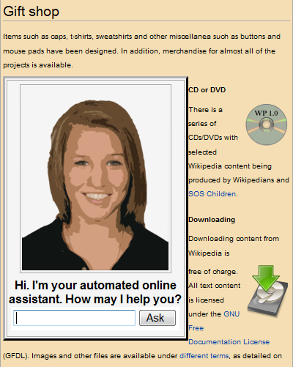

Slide 21
Explanation
Ability to explain themselves
Explain its reasoning
Convincing the accuracy to User
For explanation of a Recommendations.
Factors considered in Recommendations.
Acquire new knowledge & modification in old database.
Knowledge base should be as accurate as possible

Slide 23
Knowledge Acquisition
Include
Elicitation
Collection
Analysis
Modeling and Validation of knowledge

Slide 24
Issues for Knowledge Acquisition
Expert
Brain , Vast of Knowledge
Knowledge has “Shelf Life”
Have lot of tactic knowledge
Experiments
Problem tackling can be explained in words.
One may doesn’t know everything

Slide 25
Technique for Knowledge Acquisition
Protocol generation techniques
Interviews
Reporting and observation technique
Protocol Analysis techniques
Transcript the Interviews into knowledge base
Map Knowledge relationship
Object, Attributes and values.

Slide 26
Continued..
Hierarchy generation techniques
Creation, review and modification of knowledge
Form
Attribute Ladder
Build Taxonomies
Goal Trees and decision networks
Sorting Techniques

Slide 27
Matrix based techniques
2 –D Matrix (grid, tables) based
Concept and Properties ( Attributes and values)
Problem and solution
Task and resources
Symbol within matrix
Tick, crosses etc.
Colors, numbers , text

Slide 28
Expert System Shell

Slide 29
Example- typical MYCIN Rule
If: (1) the stain of the organism is gram-positive, and
(2) the morphology of the organism is coccus, and
(3) the growth conformation of the organism is clumps
then there is suggestive evidence (0.7) that
the identity of the organism is staphylococcus
MYCIN uses these rules to find disease-causing organisms.
Certainty factor employed to decide therapy to cure disease in MYCIN.

Slide 30
End of Slides

