Slide 1
CRYSTAL STRUCTURE
Prof. Dr. B. J. Lokhande
School of Physical Sciences

Slide 2
TYPES OF SOLIDS
In a Crystalline solid, atoms are arranged in an orderly manner. The atoms are having long range order.
  Example : Iron, Copper and other metals, NaCl etc.
In an Amorphous solid, atoms are not present in an orderly manner. They are randomly arranged.
  Example : Glass

Slide 3

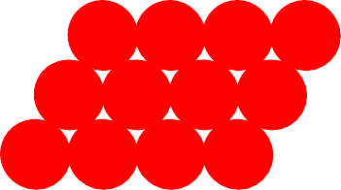
ENERGY AND PACKING
Non dense, random packing
Energy
typical neighbor bond length
typical neighbor bond energy
r
Dense, regular packing
Energy
typical neighbor bond length
typical neighbor bond energy
Dense, regular-packed structures tend to have lower energy.
r

Slide 4
SOME DEFINITIONS
Crystalline material is a material comprised of one or many crystals. In crystal, atoms or ions show a long-range periodic arrangement.
Single crystal is a crystalline material that is made of only one crystal ( no grain boundaries).
Grains are the crystals in a polycrystalline material.
Polycrystalline material is a material comprised of many crystals (single-crystal material that has only one crystal).
Grain boundaries are regions between grains of a polycrystalline material.
A unit cell is the smallest part of the unit cell, which when repeated in all three directions, reproduces the lattice.

Slide 5
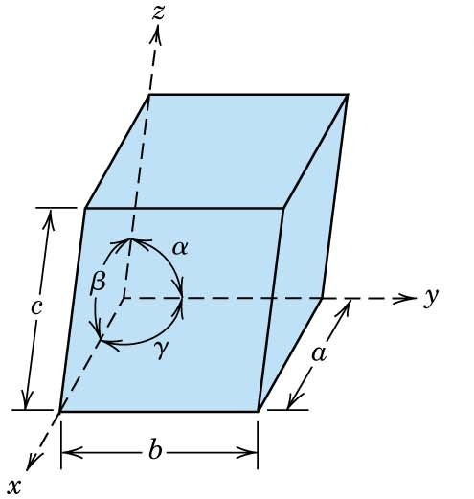
UNIT CELLS AND UNIT CELL VECTORS
All unit cells may be described via these vectors and angles.

Slide 6
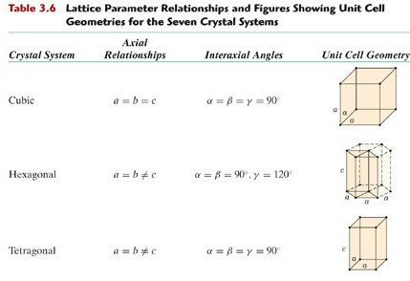

Slide 7
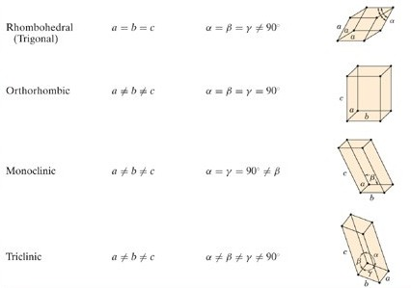

Slide 8
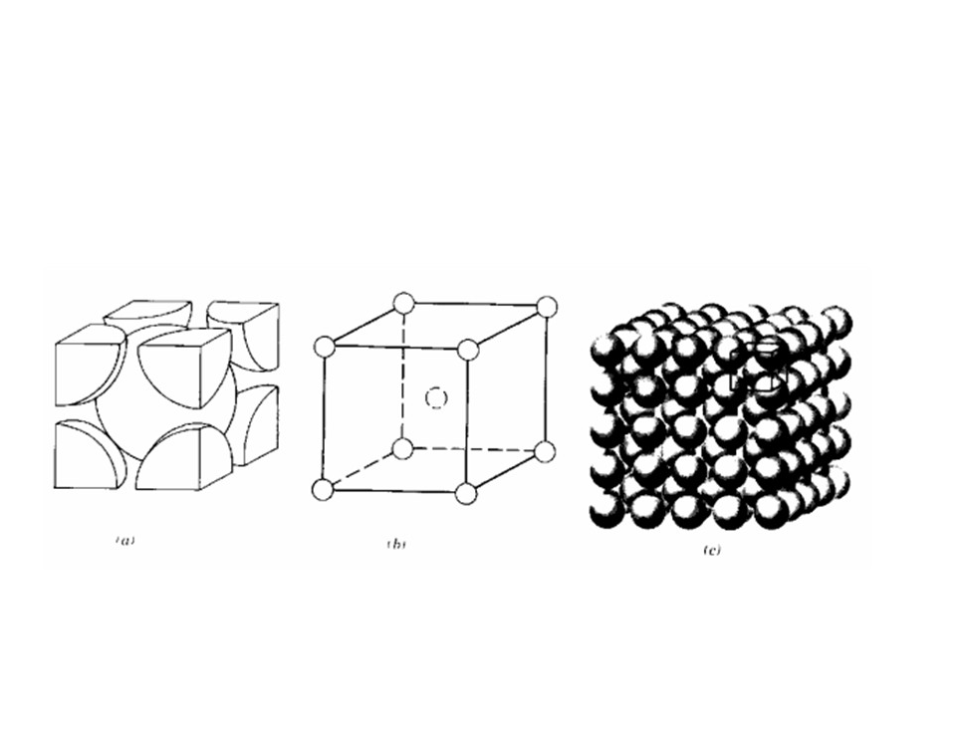
Unit Cell of BCC Lattice
Fe (Up to 910⁰ C and from 1401⁰C to Melting Point), W, Cr, V, \

Slide 9
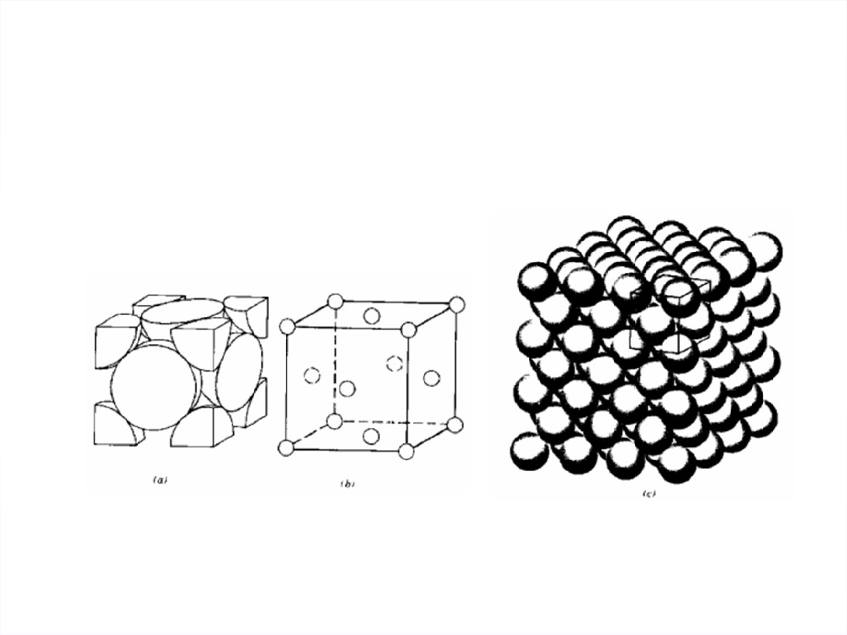
Unit Cell of FCC lattice
Al, Cu, Ni, Fe (910⁰ C-1401⁰ C)

Slide 10
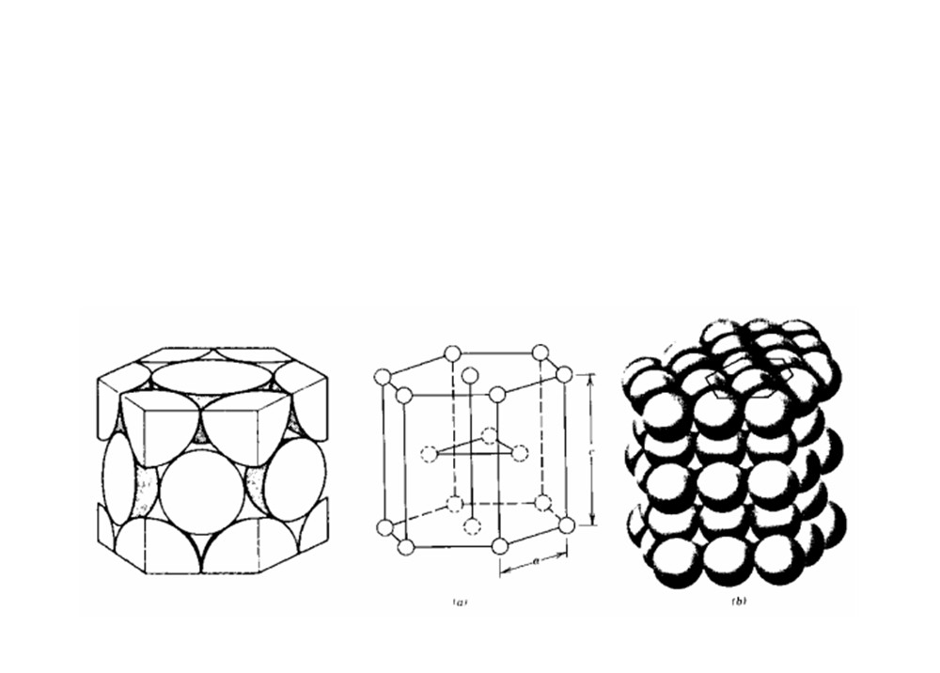
Unit Cell of Hexagonal closed packed (HCP)
Zn, Mg

Slide 11
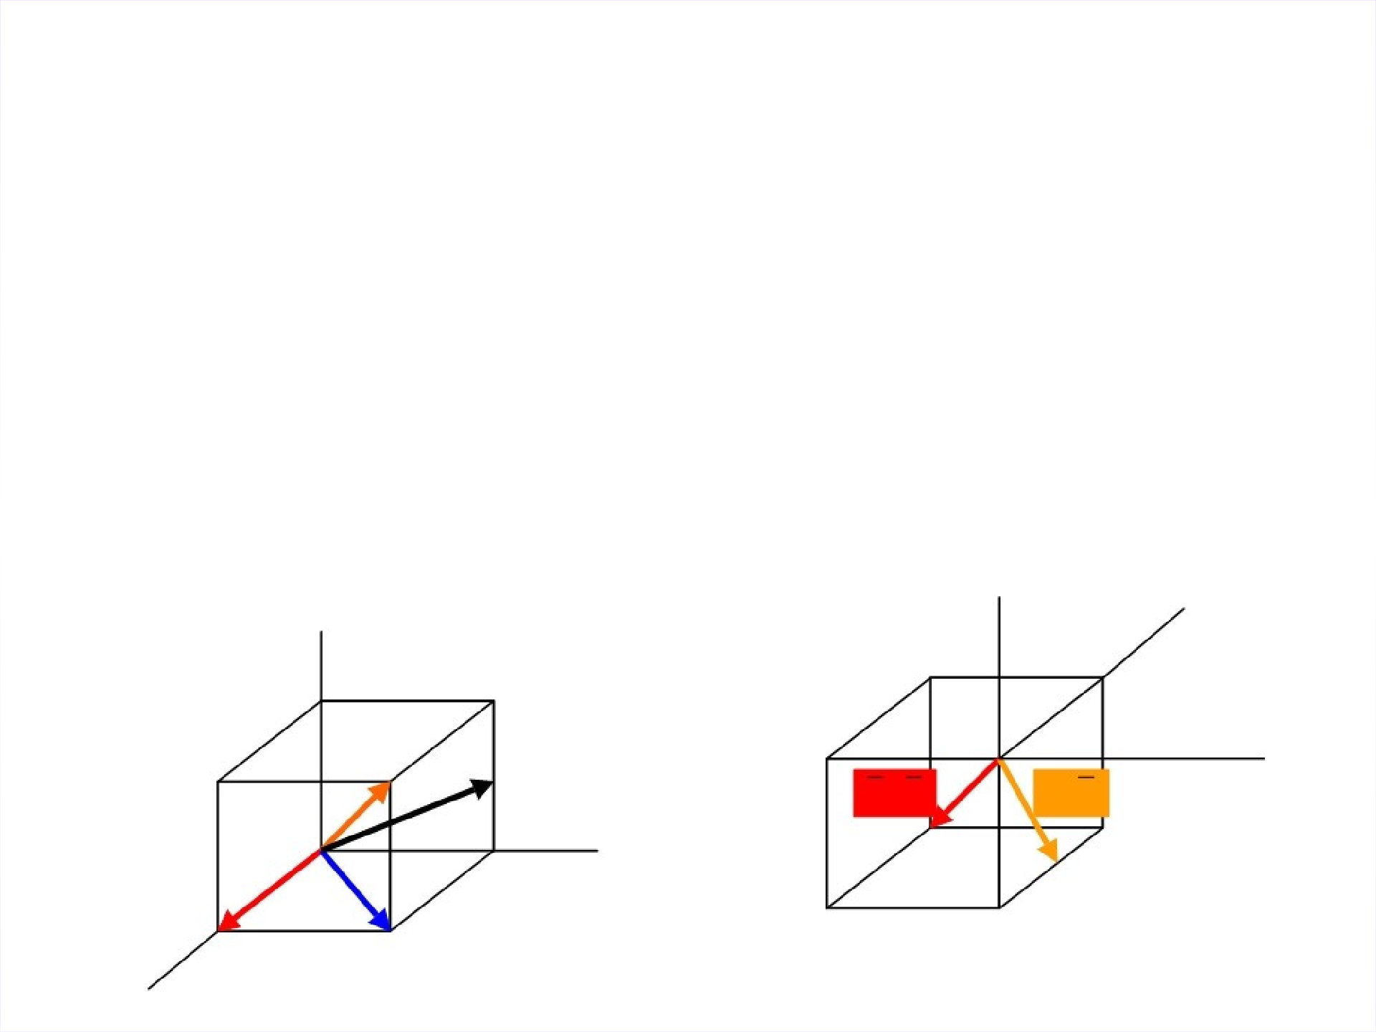
MILLER INDICES
Miller Indices are used to represent the directions and the planes in a crystal
Miller Indices is a group of smallest integers which represent a direction or a plane
y
z
y
z
x
[111]
[100]
[110]
b
[021]
[1 1 1]
[012]
x

Slide 12
MILLER INDICES
Select any point on the direction line other than the origin Find out the coordinates of the point in terms of the unit vectors along different axes.
Specify negative coordinate with a bar on top Divide the m by the unit vector along the respective axis.
Convert the result into the smallest integers by suitable multiplication or division.

